Slide 1
Support Hybrid Transactional Analytical Processing (HTAP) with Azure Synapse Link

Slide 2
What is HTAP and Synapse Link?
1

Slide 3
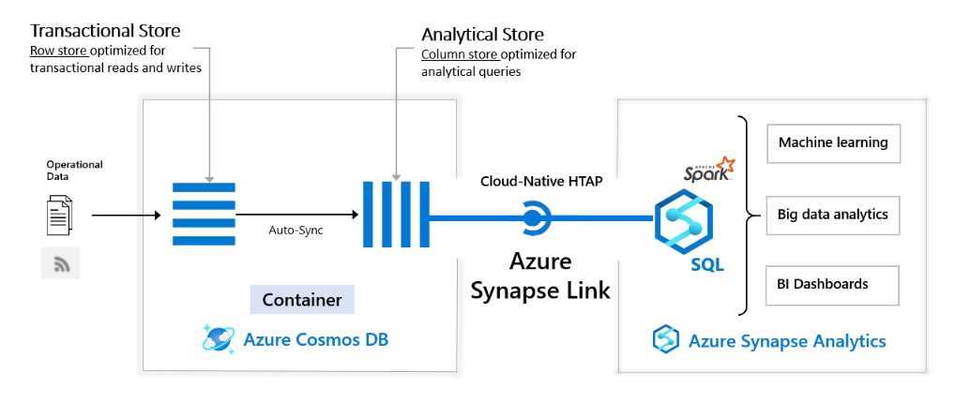
Design hybrid transactional and analytical processing using Azure Synapse Analytics
Notes:
Azure Synapse Link for Azure Cosmos DB is a cloud-native hybrid transactional and analytical processing (HTAP) capability that enables you to run near real-time analytics over operational data in Azure Cosmos DB. Azure Synapse Link creates a tight seamless integration between Azure Cosmos DB and Azure Synapse Analytics.
The architecture shown in this slide depicts how to design a hybrid transactional and analytical process using Azure Synapse Analytics.
On the left-hand side, it shows the operational data that comes in at the transactional store in a container in Azure Cosmos DB.
An auto-sync takes place to move the operational data to the analytical store, also stored in an Azure Cosmos DB container.
Then, through Cloud-Native HTAP with Azure Synapse Link, the data can be stored in Azure Synapse Analytics, where you can use the data for machine learning and analytical services.
Synapse Link brings together Azure Cosmos DB analytical store with Azure Synapse analytics runtime support. This integration enables you to build cloud-native HTAP (Hybrid transactional/analytical processing) solutions that generate insights based on real-time updates to your operational data over large datasets. It unlocks new business scenarios to raise alerts based on live trends and build near real-time dashboards and business experiences based on user behavior.
Using Azure Cosmos DB analytical store, a fully isolated column store, Azure Synapse Link enables no Extract-Transform-Load (ETL) analytics in Azure Synapse Analytics against your operational data at scale. Business analysts, data engineers, and data scientists can now use Synapse Spark or Synapse SQL interchangeably to run near real-time business intelligence, analytics, and machine learning pipelines. You can achieve this without impacting the performance of your transactional workloads on Azure Cosmos DB.
If you have different roles within you’re organizations, this could be a starting point for use cases per role to develop HTAP with Azure Synapse Analytics, Synapse Link, and Azure Cosmos DB:
A data engineer who wants to make data accessible for consumers by creating SQL or Spark tables over Azure Cosmos DB containers without manual ETL processes.
A BI engineer who wants to model and publish a report to access the operational data in Azure Cosmos DB directly through Synapse SQL.
A data analyst who wants to derive insights from the operational data in an Azure Cosmos DB container by querying it with Synapse SQL reads the data at scale and combines those findings with other data sources.
A data scientist who wants to use Synapse Spark to find a feature to improve their model and train that model without doing complex data engineering. They can also write the results of the model post inference into Azure Cosmos DB for real-time scoring on the data through Spark Synapse.
When looking at processes, Synapse Link is recommended in the following cases:
If you are an Azure Cosmos DB customer and you want to run analytics, BI, and machine learning over your operational data. In such cases, Synapse Link provides a more integrated analytics experience without impacting your transactional store’s provisioned throughput. For example:
If you are running analytics or BI on your Azure Cosmos DB operational data directly using separate connectors today, or
If you are running ETL processes to extract operational data into a separate analytics system.
In such cases, Synapse Link provides a more integrated analytics experience without impacting your transactional store’s provisioned throughput. Synapse Link is not recommended if you are looking for traditional data warehouse requirements such as high concurrency, workload management, and persistence of aggregates across multiple data sources.
For more information, see common scenarios that can be powered with Azure Synapse Link for Azure Cosmos DB.
To analyze large operational datasets while minimizing the impact on the performance of mission-critical transactional workloads, traditionally, the operational data in Azure Cosmos DB is extracted and processed by Extract-Transform-Load (ETL) pipelines. ETL pipelines require many layers of data movement resulting in much operational complexity and performance impact on your transactional workloads. It also increases the latency in analyzing the operational data from the time of origin. When compared to the traditional ETL-based solutions, Azure Synapse Link for Azure Cosmos DB offers several advantages such as:
Reduced complexity with No ETL jobs to manage
Azure Synapse Link allows you to directly access Azure Cosmos DB analytical store using Azure Synapse Analytics without complex data movement. Any updates made to the operational data are visible in the analytical store in near real-time with no ETL or change feed jobs. You can run large scale analytics against analytical store, from Synapse Analytics, without additional data transformation.
Near real-time insights into your operational data
You can now get rich insights on your operational data in near real-time, using Azure Synapse Link. ETL-based systems tend to have higher latency for analyzing your operational data, due to many layers needed to extract, transform and load the operational data. With native integration of Azure Cosmos DB analytical store with Azure Synapse Analytics, you can analyze operational data in near real-time enabling new business scenarios.
No impact on operational workloads
With Azure Synapse Link, you can run analytical queries against an Azure Cosmos DB analytical store (a separate column store) while the transactional operations are processed using provisioned throughput for the transactional workload (a row-based transactional store). The analytical workload is served independent of the transactional workload traffic without consuming any of the throughput provisioned for your operational data.
Optimized for large-scale analytics workloads
Azure Cosmos DB analytical store is optimized to provide scalability, elasticity, and performance for analytical workloads without any dependency on the compute run-times. The storage technology is self-managed to optimize your analytics workloads. With built-in support into Azure Synapse Analytics, accessing this storage layer provides simplicity and high performance.
Cost effective
With Azure Synapse Link, you can get a cost-optimized, fully managed solution for operational analytics. It eliminates the extra layers of storage and compute required in traditional ETL pipelines for analyzing operational data. Azure Cosmos DB analytical store follows a consumption-based pricing model, which is based on data storage and analytical read/write operations and queries executed . It doesn’t require you to provision any throughput, as you do today for the transactional workloads. Accessing your data with highly elastic compute engines from Azure Synapse Analytics makes the overall cost of running storage and compute very efficient.
Analytics for locally available, globally distributed, multi-master data
You can run analytical queries effectively against the nearest regional copy of the data in Azure Cosmos DB. Azure Cosmos DB provides the state-of-the-art capability to run globally distributed analytical workloads along with transactional workloads in an active-active manner.
Design hybrid transactional and analytical processing using Azure Synapse Analytics - Learn | Microsoft Docs

Slide 4
Available Synapse Link services
Which services can take advantage of Synapse Link?
Azure Cosmos DB
Enables access to the Cosmos DB analytical store from either the Synapse serverless SQL pool or Spark engine. The analytical store lives in a managed ADLS Gen2 account with automatic, near real-time, synchronization from the Cosmos DB containers to Parquet files.
Azure SQL Database
Automatic data synchronization to a Synapse dedicated SQL pool
SQL Server 2022
Automatic data synchronization to a Synapse dedicated SQL pool
Dataverse
Data synchronized to the Synapse Workspace or an ADLS Gen2 account for exploration using serverless compute in Synapse

Slide 5
Access the Cosmos DB analytical store with Spark in Synapse Notebooks
2

Slide 6
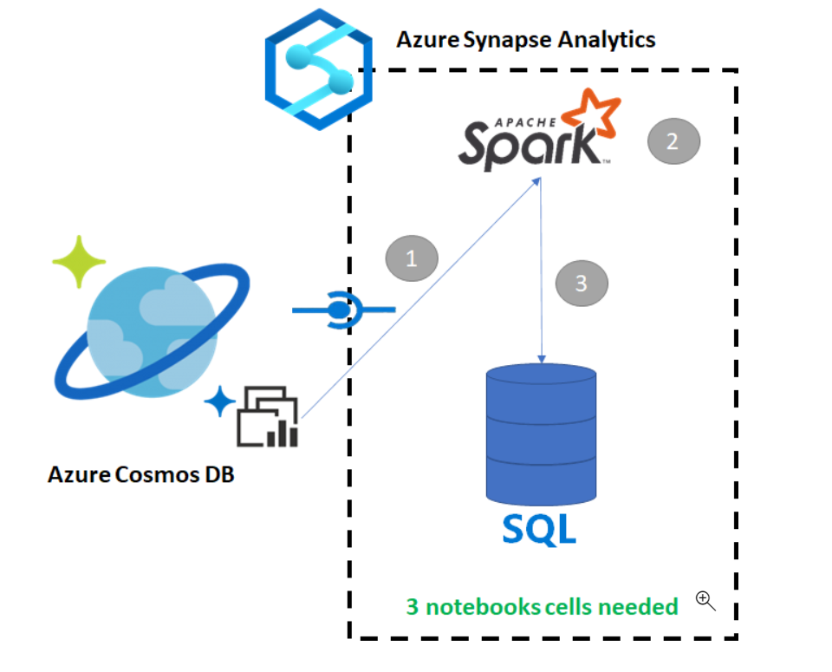
Example: Query Azure Cosmos DB with Apache Spark for Azure Synapse Analytics
Step 1: Load the data in Spark
Step 2: Create a base DataFrame
Step 3: Flatten JSON data
Step 4: Create the final DataFrame
Notes:
Azure Synapse Link for Azure Cosmos DB enables users to run near real-time analytics over operational data in Azure Cosmos DB. However, there are times when some data needs to be aggregated and enriched to serve data warehouse users. Curating and exporting Synapse Link data can be done with just a few cells in a notebook.
Certain steps that involve querying Azure Cosmos DB with SQL serverless for Azure Synapse Analytics are depicted in the slide and explained below:
Steps
When you connect to the analytical store there is no impact on the transactional store (it will not consume any Request Units).
Read the Cosmos DB HTAP container into a Spark DataFrame
Aggregate the results in a new DataFrame
Ingest the data into a SQL pool
The steps that are involved copying data from an Azure Cosmos DB into a SQL Pool while using Apache Spark or a SQL script enabled in Synapse analytics are as follows:
1. Load the data in Spark
2. Create a base DataFrame
3. Flatten JSON data
4. Create the final DataFrame
Query Azure Cosmos DB with SQL Serverless for Azure Synapse Analytics - Learn | Microsoft Docs

Slide 7
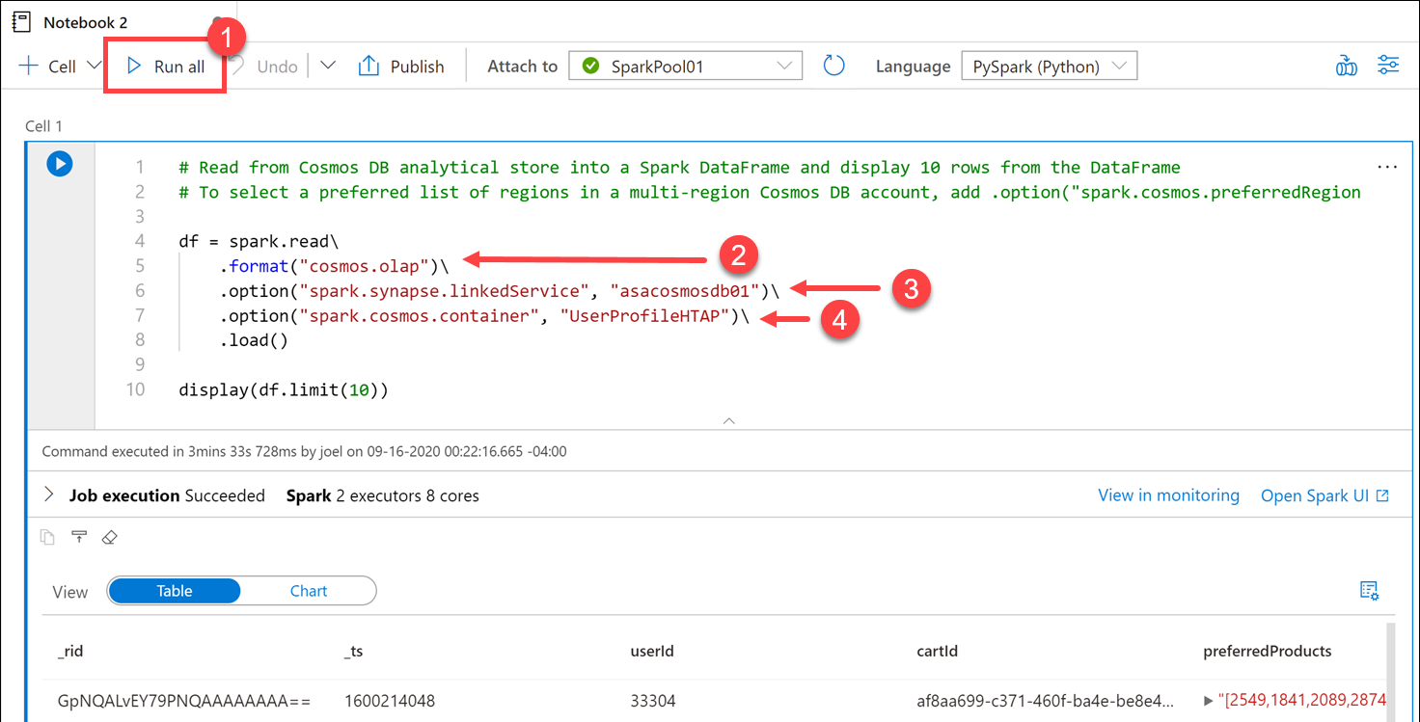

Query Azure Cosmos DB with Apache Spark for Azure Synapse Analytics (continued #1)
Step 1:
Load data to DataFrame
Notes:
Step1 : Load data to DataFrame
In this step, you'll read data from Azure Cosmos DB analytical store in a Spark DataFrame.
Once your data is loaded into a DataFrame, you can perform additional analysis.
This operation doesn't impact the transactional store.
In the generated code within Cell 1, notice that the spark.read format is set to cosmos.olap (2). This instructs Synapse Link to use the container's analytical store. If we wanted to connect to the transactional store instead, like to read from the change feed or write to the container, we'd use cosmos.oltp instead. Note: You cannot write to the analytical store, only read from it. If you want to load data into the container, you need to connect to the transactional store. The first option configures the name of the Azure Cosmos DB linked service (3). The second option defines the Azure Cosmos DB container from which we want to read (4).
https://docs.microsoft.com/en-us/learn/modules/query-azure-cosmos-db-with-apache-spark-for-azure-synapse-analytics/

Slide 8
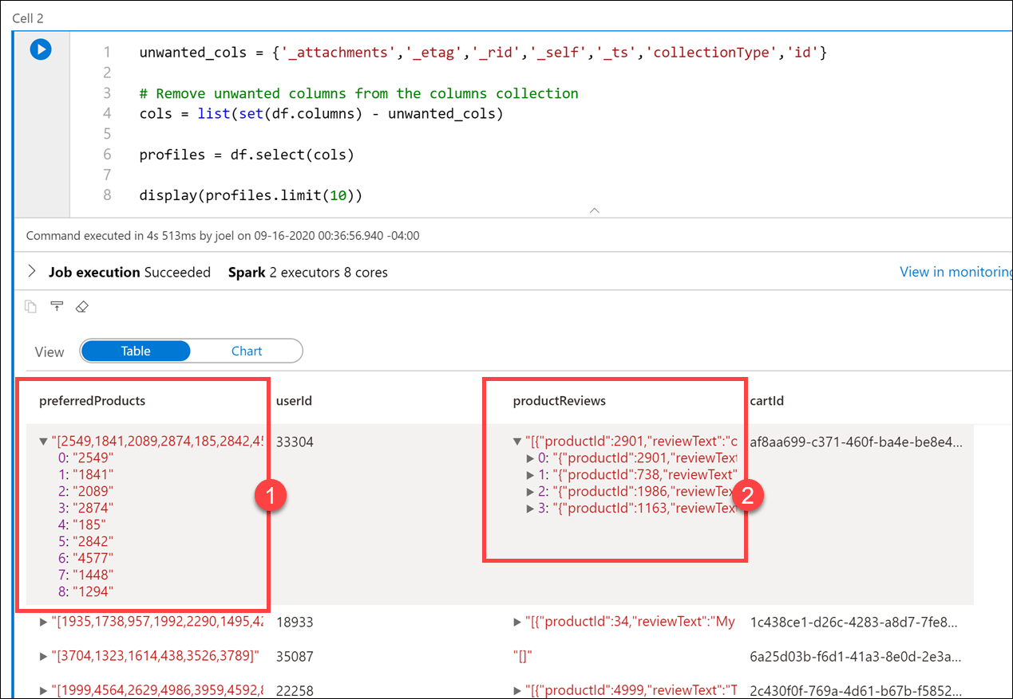
Query Azure Cosmos DB with Apache Spark for Azure Synapse Analytics (continued #2)
Step 2:
Create a base DataFrame
Notes:
Step 2: Create a base DataFrame
Here you'll create a base DataFrame pointing to the container you selected.
The DataFrame contains extra columns that we don't need. Let's remove the unwanted columns and create a clean version of the DataFrame. To do this, enter the following in the new cell and run it:
unwanted_cols = {'_attachments','_etag','_rid','_self','_ts','collectionType','id'}
# Remove unwanted columns from the columns collection
cols = list(set(df.columns) - unwanted_cols)
profiles = df.select(cols)
display(profiles.limit(10))
The output now only contains the columns that we want. Notice that the preferredProducts (1) and productReviews 2 columns contain child elements. Expand the values on a row to view them. You may recall seeing the raw JSON format in the UserProfiles01 container within the Azure Cosmos DB Data Explorer.
https://docs.microsoft.com/en-us/learn/modules/query-azure-cosmos-db-with-apache-spark-for-azure-synapse-analytics/

Slide 9
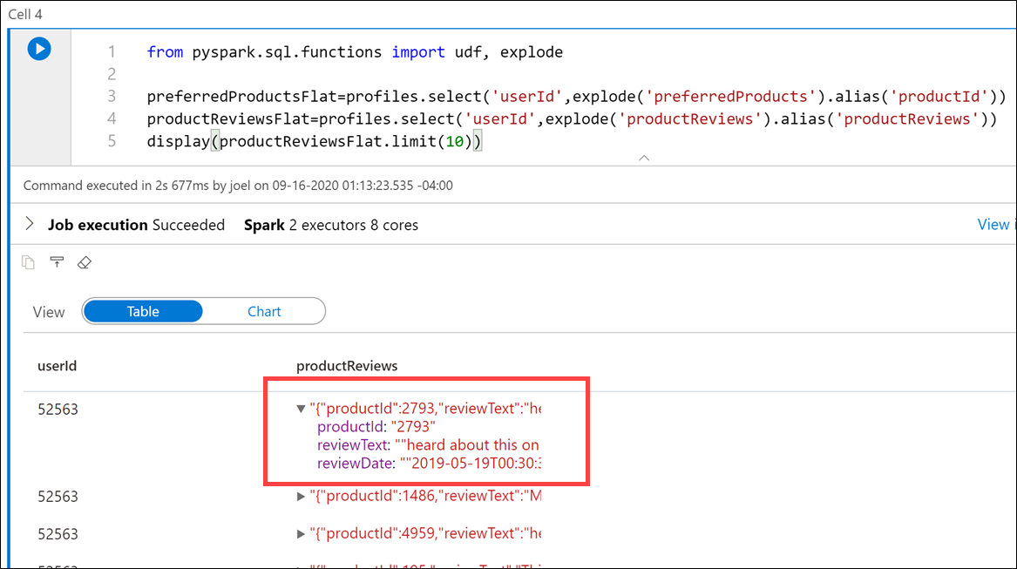
Query Azure Cosmos DB with Apache Spark for Azure Synapse Analytics (continued #3)
Step 3:
Flattening JSON data
Notes:
Step 3: Flattening JSON data
We want to use the preferredProducts column array and productReviews column array for each user and create a graph of products that are from their preferred list that match with products that they have reviewed. To do this, we need to create two new DataFrames that contain flattened values from those two columns so we can join them in a later step.
In this cell, we imported the special PySpark explode function, which returns a new row for each element of the array. This function helps flatten the preferredProducts and productReviews columns for better readability or for easier querying. You can flatten the dataset as many times as you need to structure the data the way you want it
https://docs.microsoft.com/en-us/learn/modules/query-azure-cosmos-db-with-apache-spark-for-azure-synapse-analytics/

Slide 10
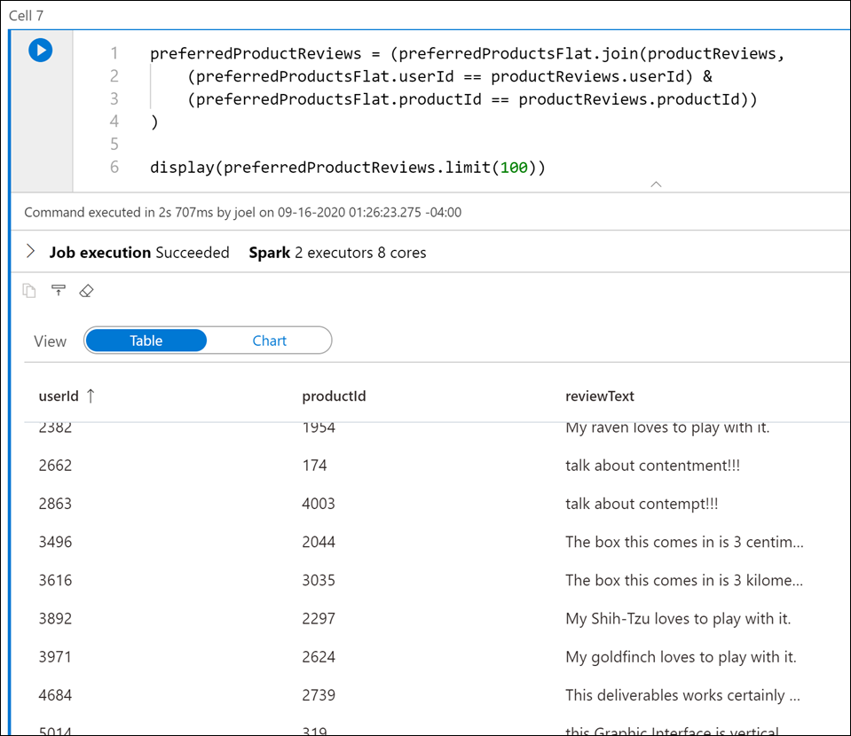
Query Azure Cosmos DB with Apache Spark for Azure Synapse Analytics (continued #4)
Step 4:
Creating the final DataFrame
Notes:
Step 4: Creating the final DataFrame
The final step is to join the preferredProductsFlat and productReviews DataFrames on the userId and productId values to build our graph of preferred product reviews. To do this, enter the following in a new cell and run it:
preferredProductReviews = (preferredProductsFlat.join(productReviews,
(preferredProductsFlat.userId == productReviews.userId) &
(preferredProductsFlat.productId == productReviews.productId))
)
display(preferredProductReviews.limit(100))
https://docs.microsoft.com/en-us/learn/modules/query-azure-cosmos-db-with-apache-spark-for-azure-synapse-analytics/

Slide 11
Query the Cosmos DB analytical store with serverless SQL pool
3

Slide 12
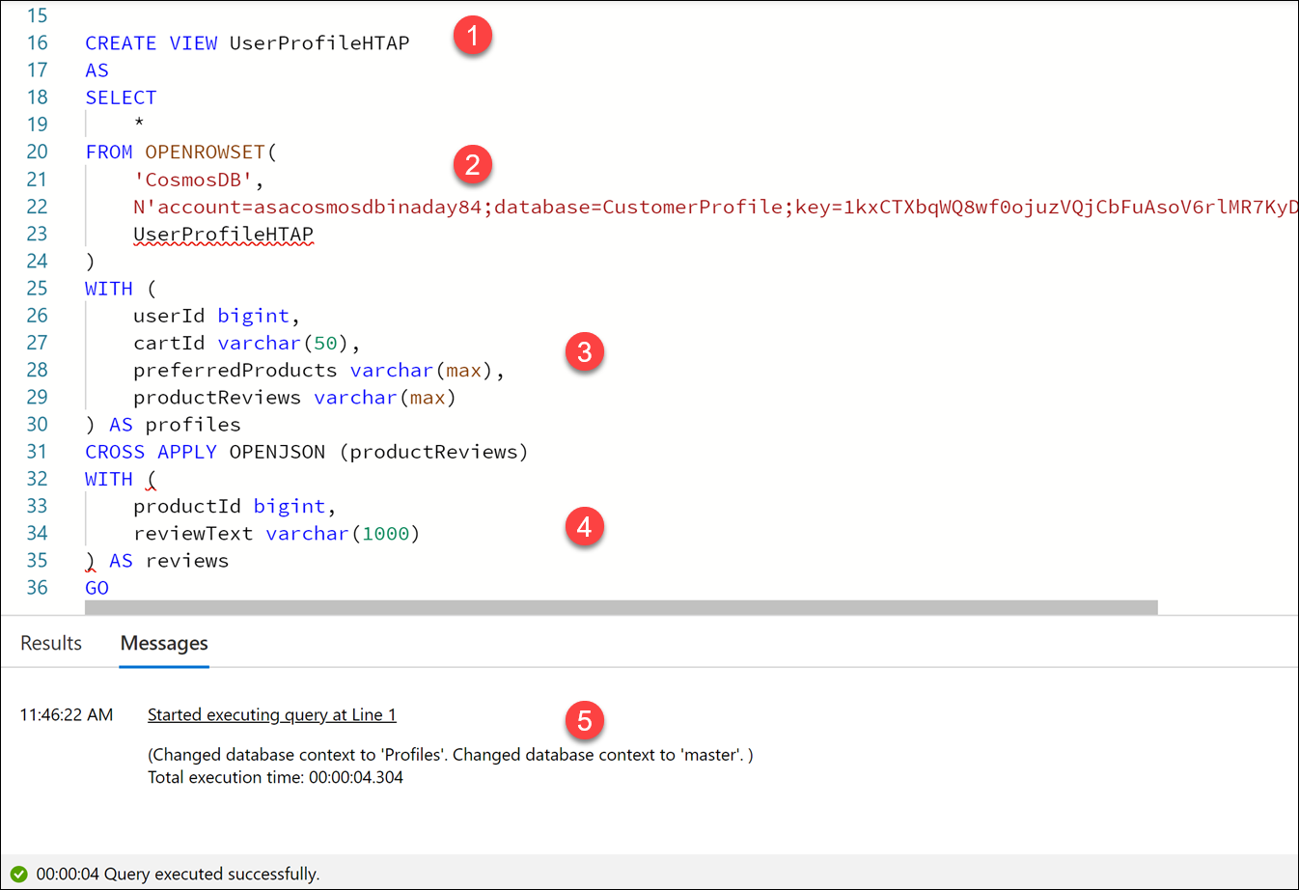
Query Azure Cosmos DB with SQL Serverless for Azure Synapse Analytics
Create a View
Notes:
The query starts out by creating a new serverless SQL pool database named Profiles if it does not exist, then executes USE Profiles to run the rest of the script contents against the Profiles database. Next, it drops the UserProfileHTAP view if it exists. Finally, it performs the following:
Creates a SQL view named UserProfileHTAP.
Uses the OPENROWSET statement to set the data source type to CosmosDB, sets the account details, and specifies that we want to create the view over the Azure Cosmos DB analytical store container named UserProfileHTAP.
The WITH clause matches the property names in the JSON documents and applies the appropriate SQL data types. Notice that we set the preferredProducts and productReviews fields to varchar(max). This is because both of these properties contain JSON-formatted data within.
Since the productReviews property in the JSON documents contain nested subarrays, we want to "join" the properties from the document with all elements of the array. Synapse SQL enables us to flatten the nested structure by applying the OPENJSON function on the nested array. We flatten the values within productReviews like we did using the Python explode function earlier in the Synapse Notebook.
The output shows that the statements successfully executed.
This is just one example. You can create queries that perform cross-container queries, query JSON data, and use aggregation or windowing functions within the queries
https://docs.microsoft.com/en-us/learn/modules/query-azure-cosmos-db-with-sql-serverless-for-azure-synapse-analytics/

Slide 13
LAB 14: Using Azure Synapse Link for Azure Cosmos DB
60 minutes

